Slide 1

CUSTOMER RETENTION
- Prachi Parmar

Slide 2
Customer retention strategies enable you to both provide and extract more value from your existing customer base. You want to ensure the customers you worked so hard to acquire stay with you, have a great customer experience, and continue to get value from your products. In short, acquisition creates a foundation of customers while your retention strategy is how you build customer relationships and maximize revenue for each one. But how much time and resources should you devote to your retention program? The answer to that depends on your store.
ABSTRACT

Slide 3





Main Objective of the problem statement is to find the parameters that influences the customers to stay with a online retailer. To Find patterns in the customer behavior according to their likes and dislikes that influenced the target being which online retail website customer recommend the most. The Target of this problem is to know according to the survey of a customer, which online retail websites a customers would recommend from (Amazon/ Flipkart/ Myntra/ Paytm/ Snapdeal). This Problem Statement involves recommending 1 or more websites making this a Multi-target Classifier Problem.
MAIN OBJECTIVE

Slide 4
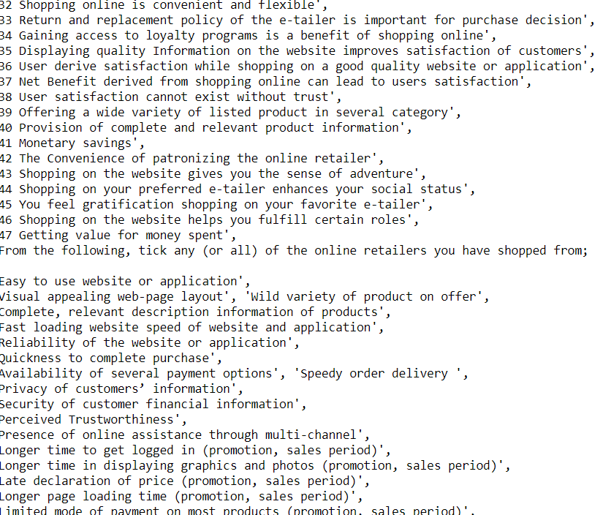
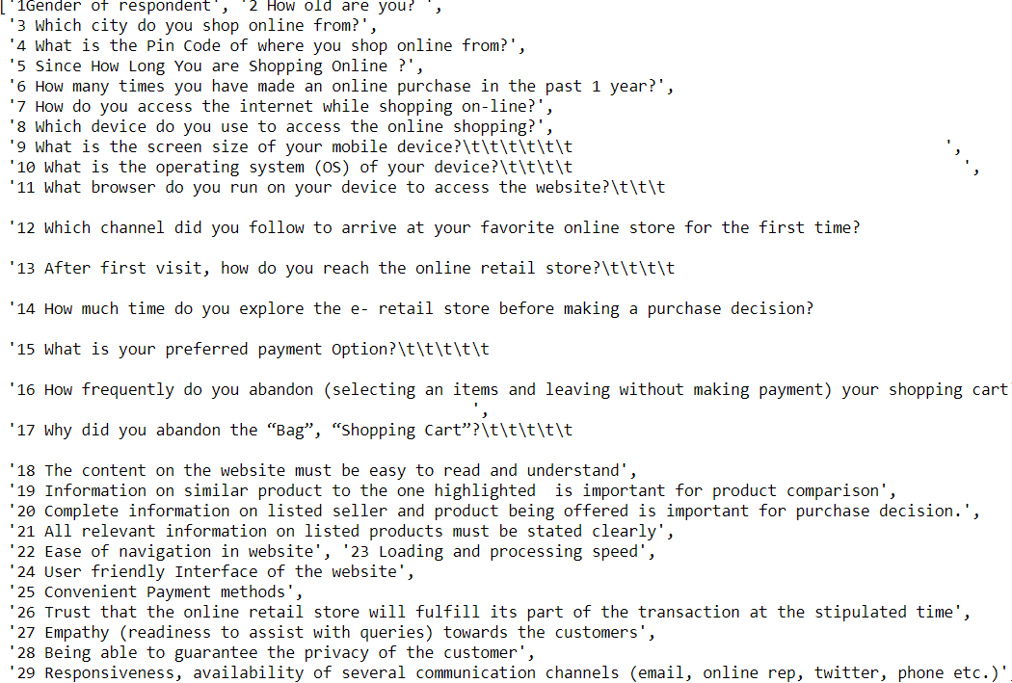
- There are total 71 Features. Data Type of all the Features are objects i.e Categorical Data. - No Missing Values. There were some duplicate categories. - Refer the Below Questions to see the Survey question .
DATA INFORMATION

Slide 5
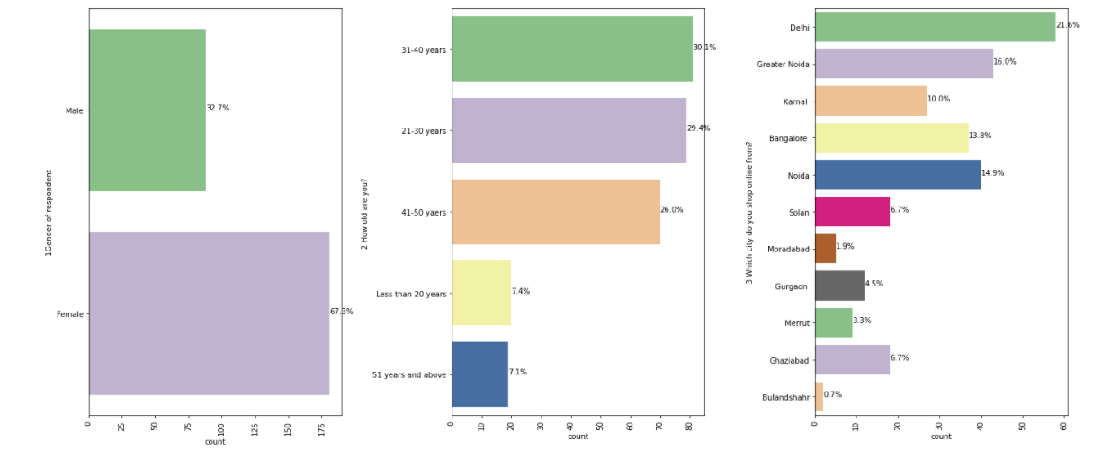
67% of the customers were Female, 32% of the customers were Male.
Most of the Customers belong to the Age group of 31-40, 21-30 Years old. (around 60% of the customers)
Majority of the Customer shop from Delhi, Noida, Greater Noida side of the Customer, around 51%.
DATA VISUALIZATION - 1

Slide 6
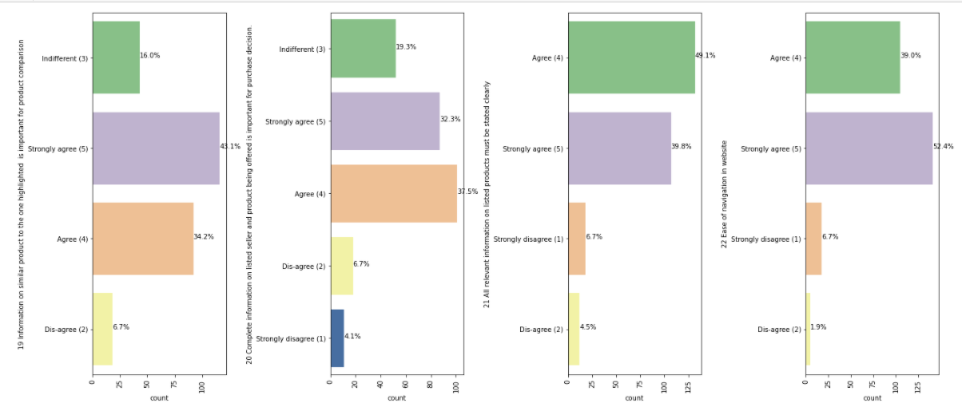
More than 70% of the customers strongly agree/agree to the fact that info about the similar product to the one highlighted is import for product comparison
Around 70% of the customers agree/strongly agree that information about the seller is important for purchase decision of a product.
90% of the customers feel that relevant information about the product should be stated clearly.
94% of the customers find the ease for navigation is important.
DATA VISUALIZATION - 2

Slide 7
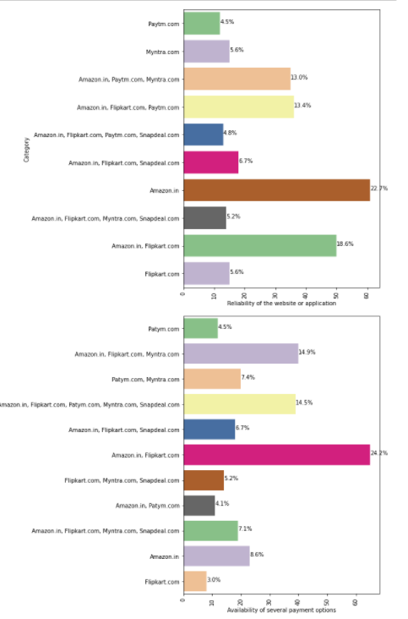
Reliability of the Website, most of the customers fell the Amazon and Flipkart are the most reliable websites.
For all the Available Payment Options, Amazon and Flipkart has most of the payment option
DaTA VISUALIZATION - 3

Slide 8
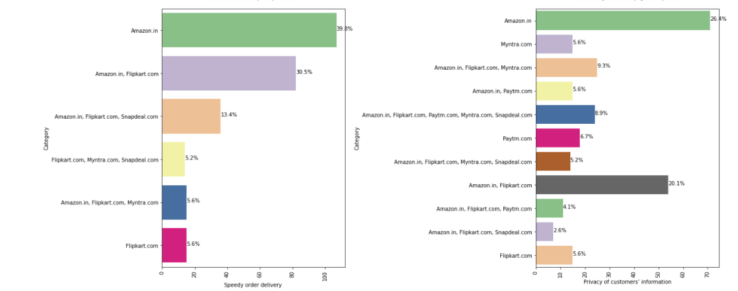
Amazon has the Most Speedy order Delivery, After then Flipkart delivers the fastest.
Amazon is the most trusted website for customer’s information, then comes Flipkart, then Myntra.
DATA VISUALIZATION - 4

Slide 9
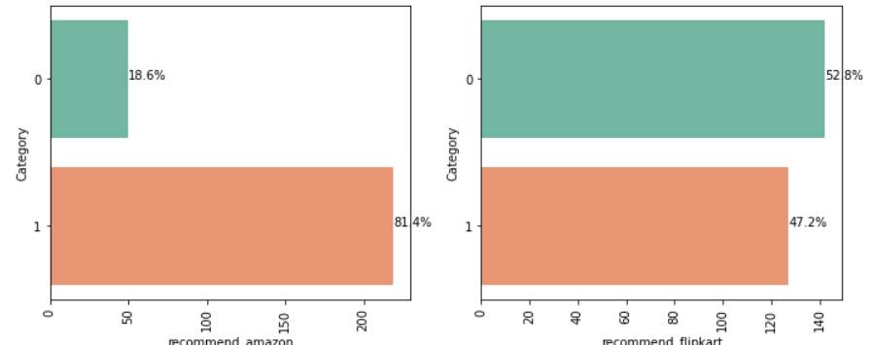
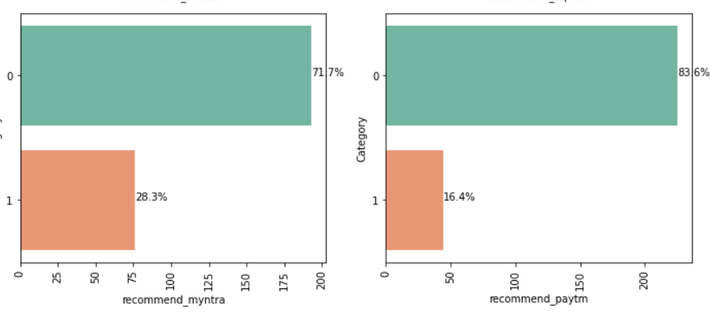
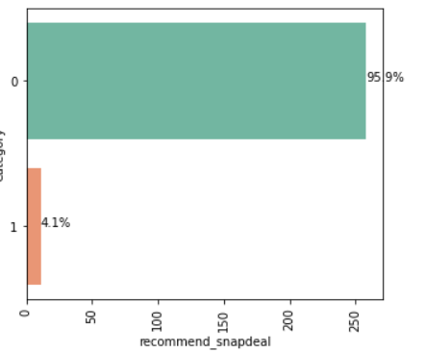
Amazon is most recommended by 81.4% of the Customers
47% of the Customers recommended Flipkart.
Paytm has recommended by 16.4% of the Customers.
Myntra is recommended by 28% of the customers.
Snapdeal is the least recommended online retailed with only 4% of recommendation Rate.
DATA VISUALIZATION ON RECOMMENDATION of online retailer

Slide 10
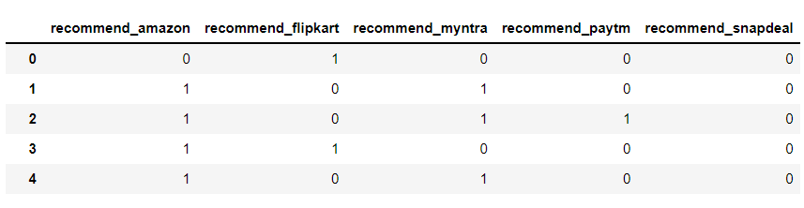
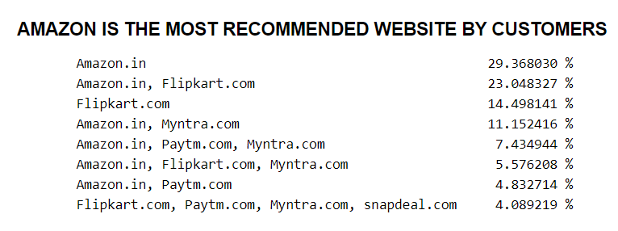
The Categories of the target are as such as in the below, These categories can be converted into different columns as in ONE-HOT Encoder which looks like →
TARGET - VARIABLE
MULTI – Output targets

Slide 11
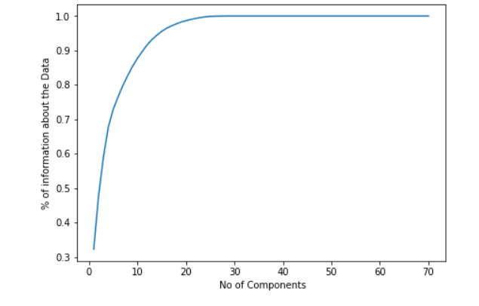
As all the predictors are categorical data, we need to encode it using LabelEncoder.
No missing values, duplicate categories created and merged as one.
No outlier treatment required in Categorical Data.
PCA for Feature Selection, Noise Component Removal and Dimension Reduction.
PCA plots No of components Vs % of information about the Data.
PCA Tells us out of 71 components, up to 30 components are able to give us 100% information about the target variable.
Noise component is high, So we train out model using 30 Components
DATA PREPROCESSING

Slide 12
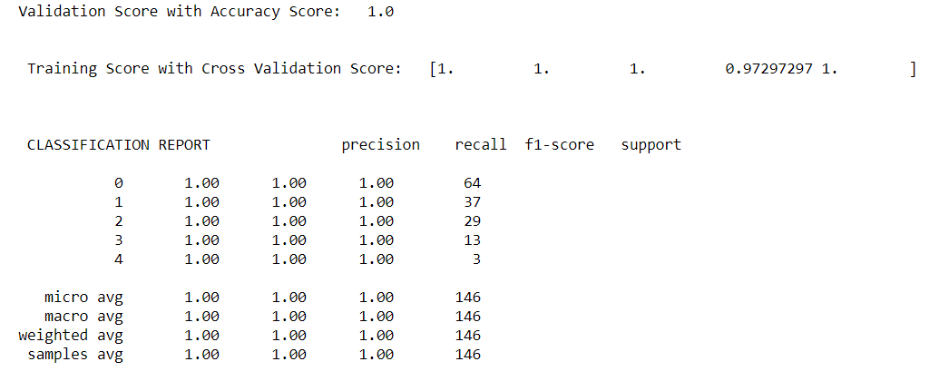
Metrics for evaluation is : Accuracy Score
Metrics for training: cross validation score.
Model is trained with RANDOMFOREST CLASSIFIER
Accuracy Score: 1.0
Training Score of : 1.0
Precision/recall score of all the targets are : 1.0
MODEL Evaluation

Slide 13
There are also limitations in my research. First, the sample group is not wildly enough; I used a Chinese Email list, so the opinion of customer is not in an international scope. Second, the questionnaire question could be designed more skillful.
During the research process of this thesis some more interesting research areas are come out. The relationship between E-satisfaction, E-service quality, E-loyalty and Switch barriers. How exactly they affect each other.
I have some little discussion in this thesis but it still need further investigate and prove How to use member community to improve customer relationship
Limitations

Slide 14
To conclude, having the right customer retention strategy will keep your company grows if you know how to take advantage of it. Your customers will find their way back and continue buying stuff from you. At the end of the day, what you need to do is fulfilling your customers’ needs, listen to their complaints and provide professional solutions.
If your customers feel like they are valued, they will become increasingly loyal to your brand. Keep in mind the Pareto principle: 20% of your customers are responsible for 80% of your sales.
Treat them right, personalize your communication, show your appreciation on special occasions and always give them a reason to choose you over any other competitor. It’s the safest and most effective way of creating strong relationships that stand the test of time. And also the shortest road to increased customer retention rates.
Conclusion

Slide 15


